Slide 1
ART 1600 – The Aesthetics of Architecture, Interiors, and Design Matthew Ziff, Associate Professor, M. Arch, Architect, NCIDQ Spring Semester 2017
A Vocabulary of Design 2 Design Concepts & Vocabulary

Slide 2
Influential Architectural Form: Private & Small Scale
In “A Vocabulary of Design 1” we looked at large public works of design, architecture, and interiors.
In this set of images and text we will look at small private works of design.

Slide 3
Why do physical man made products and objects look the way they do?
Why are these things made of what they are made of?
Why are the same kinds of things different in one time, in one place, from another?
things that happen across time = diachronic
Ancient times – Renaissance – Modern
things that happen at the same time = synchronic
Right now: raining in Hong Kong, sunny in Ohio

Slide 4
Form, Function, Material, Technology
the relationships between these four fundamental characteristics of any architectural, or interior work is how we evaluate them in terms of their importance and their ‘success’ as works of design.
Form always has a relationship to Function.
Material always has a relationship to how something is made (Technology).
Form always has a relationship to Material.
Form also has a relationship to technology.

Slide 5
Influential Architectural Form: Private & Small Scale: Furniture and Objects
Egyptian: 2,800 BC
Greek: 600 BC – 300 BC
Medieval: 1200 AD
European Renaissance: 1750 AD
Industrial Revolution: 1850 AD
Early Modern: 1880 – 1900
Modern: 1920 – 1970
Post-Modern & Contemporary: 1970 - today

Slide 6
Egyptian furniture
The ancient Egyptians did not have much furniture and not much of that has survived.
The most common furniture was a low stool, although many people, especially poor sitting on the floor.
Rich people had beds and mattresses, while the poorest people slept on a straw mat or carpet on the floor.
The ancient Egyptians did not have closets, things were stored in baskets made of reeds.

Slide 7
Egyptian furniture Couch with lion sides and high curling tail. The face shows the nose, eye frames and tear drops of blue glass.

Slide 8
Couch in the form of a cow, an image of the goddess Mehetweret "the great flood."

Slide 9
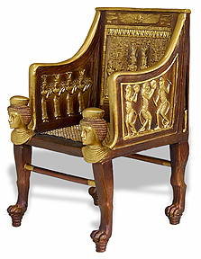
Egyptian Royal thrones

Slide 10
Egyptian bed

Slide 11
Ancient Greek furniture The Klismos chair This is a reproduction: no original wood Klismos chairs exist today.

Slide 12
Stone sculpture showing what the Greek Klismos chair looked like

Slide 13
The number of objects that existed in ancient times was far, far less than what we have, and take for granted, today.
Possessions were few, there were no machines, metals were valuable and difficult to work with.
The remaining objects from ancient times are stone buildings, pottery, jewelry and stone carvings.

Slide 14
A poster originally published in February, 1907, Popular Mechanics magazine, showing some of the historic styles of chairs, from Egyptian, to Henry II in England.

Slide 15
And from Louis XIII in France to Mission Style, 1890’s in England.

Slide 16
Stool based upon an Ancient Greek design

Slide 17
“When all you have is a hammer, the whole world looks like a nail.”
The first recorded statement of the concept was Abraham Kaplan's, in 1964: "I call it the law of the instrument, and it may be formulated as follows: Give a small boy a hammer, and he will find that everything he encounters needs pounding.”
Maslow's hammer, popularly phrased as "if all you have is a hammer, everything looks like a nail" and variants thereof, is from Abraham Maslow's The Psychology of Science, published in 1966.
It has also been called the law of the hammer, attributed both to Maslow and to Kaplan.

Slide 18
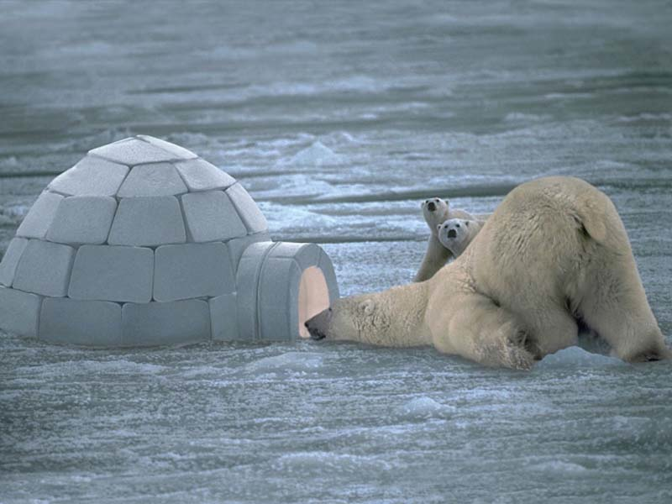
The form of ancient architecture and small scale objects such as furniture, was greatly influenced by the materials and the technology available to make these items.
Stone for buildings was hand cut and chiseled, which took a great amount of time.
Wood for furniture was hand cut, and the shapes they created were a reflection of their cultural and visual aesthetic, constrained by the tools and concepts of how to use them of their time.
There were no igloos in Egypt!

Slide 19
Late Medieval oak hutch, English, 1490 – 1500 AD

Slide 20
Heavy and rough construction

Slide 21
European Renaissance: 1300 – 1600 AD French Renaissance cabinet, 1500’s Becoming more refined and delicate

Slide 22
Flemish (a part of Belgium) Renaissance cabinet, circa 1580’s (‘circa’ from Latin meaning ‘around’; an approximate date when the exact date is unknown)

Slide 23
The Francis I Renaissance Sideboard, 1500’s highly ornamented, very precise workmanship

Slide 24
The exterior is made entirely of walnut, with a sturdy oak interior.

Slide 25
Louis XV chair, 1723 – 1774, France highly ornate, delicate, showy

Slide 26
Why didn’t King Louis XV have a chair like this?

Slide 27
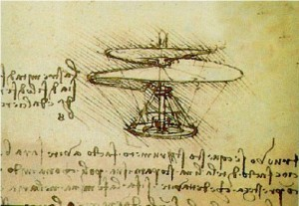
Because nothing involved in the conceptualizing, designing or
fabricating of this chair existed in the time of Louis XV.
Could this chair have been conceived by anyone in 1700?
Look at what Leonardo Da Vinci was thinking about in 1493:

Slide 28
Leonardo da Vinci’s helicopter is a famous example of his thinking centuries ahead of his time.
It is the first known drawing of any helicopter-like machine.
The ancient Chinese had designs for lighter than air flight, such as hot air balloons and even some wild firework powered machines (some of which are believed to have been tested resulting in the death of the pilot) but nothing similar to a helicopter.
The design was drawn in 1493, 450 years earlier than an actual helicopter would take to the air. The main blade was 2 meters in diameter, the min supporting structure would be held together by reeds.

Slide 29
Leonardo Da Vinci’s ‘helicopter’ 1493

Slide 30
Louis XV wall-console table

Slide 31
Louis XV furniture highly ornate, sweeping curves, upholstery fabrics

Slide 32
Louis XVI chair, France 1750

Slide 33
Louis XVI style is influenced by discoveries at Pompeii The result is furniture and décor with cleaner, straighter, lines and shapes.

Slide 34
In Louis XVI furniture there is an emphasis on straight lines and right angles, seriousness, logical design, a sharp move away from the curves of the Rococo.

Slide 35
Machines changed everything
The Spinning Wheel: A 3 minute video
Steam power: the steam engine is invented: a 1 minute video
The development of the stationary steam engine was an essential element of the Industrial Revolution.
The world was becoming an industrialized place before the invention of steam power, but it would not have progressed so quickly without it.
Factories that still relied on wind or water power to drive their machines during the Industrial Revolution were confined to certain locales. Steam engines allowed factories to be built anywhere, not just along rivers.

Slide 36
A steam powered engine placed on top of a set of wheels.

Slide 37
A steam powered engine made into a locomotive.

Slide 38
Early Modern: 1880 – 1900 Industrial Revolution ‘objects’

Slide 39
Machines and a new ‘machine aesthetic’
The machine was valued for its service. Its aesthetic was promoted by those who saw a beauty in the machine -- a beauty that connected appearance and function.
The machine aesthetic was assumed by all sorts of objects. Shiny metals, molded plastics, and mirrored glass became important decorative devices.
This ‘aesthetic of the machine’ became a foundation piece in Modern thinking, and in Modern design.
A machine aesthetic is even today highly regarded by many designers.

Slide 40
A heavy duty, visually expressed functionality: All of the pieces and parts play a functional role: ‘Form Follows Function’

Slide 41
Today we see these as ‘beautiful’ in part because they are old (antique) and in part because of the vigorous functionality

Slide 42
Industrial Revolution object ‘Re-Purposed’

Slide 45
Spinning jenny, invented by James Hargreaves in 1764: it spins several threads at once This machine radically changed the textile industry, making textiles available in previously unimaginable quantities.

Slide 46
Hand sewn clothes: slow, time intensive, limited production.

Slide 47
Shirts at a big box retailer 2017

Slide 48
Spinning jenny, invented by James Hargreaves in 1764

Slide 49
Machines became the dominant presence wherever manufacturing took place. Women and children were often employed at low wages.

Slide 50
There were no child labor laws during this time

Slide 52
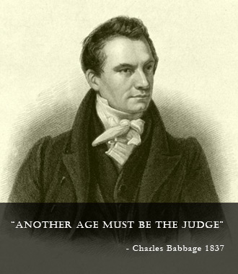
The Babbage Engine
Charles Babbage (1791-1871), computer pioneer, designed the first automatic computing engines.
He invented computers but failed to build them.
The first complete Babbage Engine was completed in London in 2002, 153 years after it was designed.
Difference Engine No. 2, built faithfully to the original drawings, consists of 8,000 parts, weighs five tons, and measures 11 feet long.

Slide 53
Mass production required mass labor.

Slide 54
Unsafe and unhealthy working conditions were rampant in the mid 1800’s – 1910’s.

Slide 55
Ancoats, England, 1870’s Coal fired factories and home heating produced thick dirty air.

Slide 56
Air pollution in the English town of Widnes in the late 19th century.

Slide 57
Oak washstand by Liberty & Co., England, circa 1894. Hand made furniture.

Slide 58
Arts and Crafts oak desk designed by Gustav Stickley, circa 1903,

Slide 59
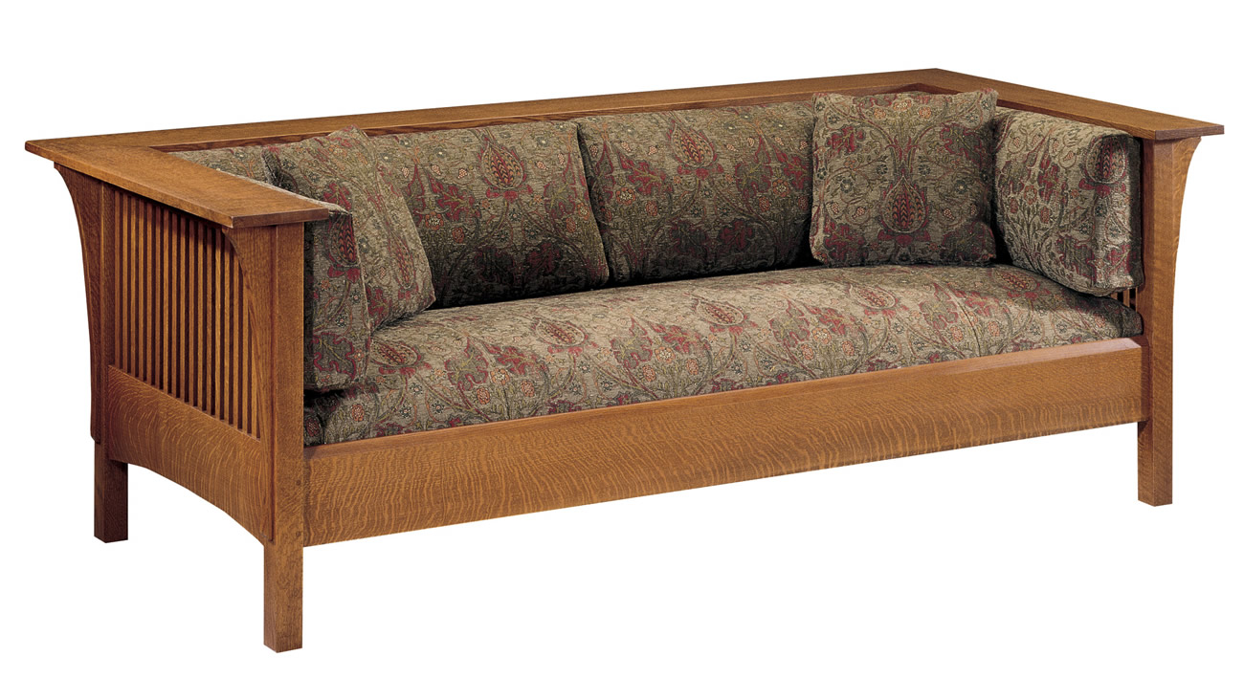
Stickley furniture company (an especially interesting American furniture company)

Slide 60
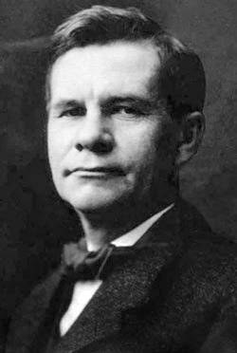
Gustav Stickley, 1912

Slide 61
In October 1901, Stickley published the first issue of The Craftsman magazine, an important vehicle for promoting Arts and Crafts philosophy as well as the products of his factory within the context of articles, reviews, and advertisements for a range of products of interest to the homemaker.
Stickley's new furniture reflected his ideals of simplicity, honesty in construction, and truth to materials.
Unadorned, plain surfaces were enlivened by the careful application of colorants so as not to obscure the grain of the wood and mortise and tenon joinery was exposed to emphasize the structural qualities of the works.

Slide 62
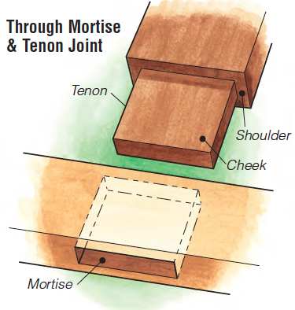
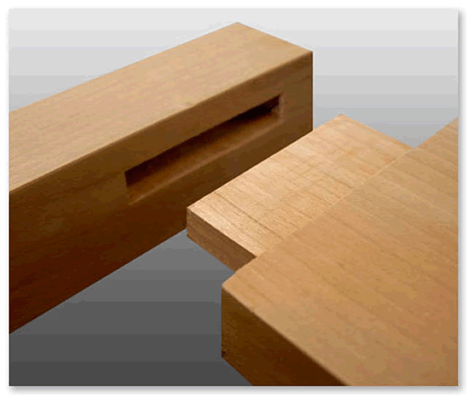
A classic furniture joinery technique: mortise & tenon

Slide 64
‘Morris’ chair by Stickley

Slide 65
‘Prairie Chair’ by Stickley

Slide 66
Stickley ‘Prairie Chair’

Slide 67
Modernism 1910 + - to 1970 + -
A socially progressive trend of thought that affirms the power of human beings to create, improve and reshape their environment with the aid of practical experimentation, scientific knowledge, and technology.

Slide 68
Modernism: 1910 +- to 1970 +-
The approach of the Modernist architects (1910 – 1970) was to reduce buildings to pure forms, removing historical references and ornament in favor of functionalist details.
Buildings that displayed their construction and structure, exposing steel beams and concrete surfaces instead of hiding them behind traditional forms, were seen as beautiful in their own right.
Architects such as Mies van der Rohe worked to create beauty based on the inherent qualities of building materials and modern construction techniques, trading traditional historic forms for simplified geometric forms, celebrating the new means and methods made possible by the Industrial Revolution.

Slide 69
Modernism
In essence, what Modernism proposed was a change from what was happening (19th century academic and historicist traditions) to a better kind of life through industries and technology.
Modern architecture is a style defined by simplification of form and the elimination of ornament.
It arose in the first half of the 20th century and it gained popularity after World War II.

Slide 70
Some movements that defined modern architecture included International Style and De Stijl.
Modern architecture began as an intellectual movement in Europe and was taken up in the USA.
Some of the most important of the Modern architects in Europe were Le Corbusier, Walter Gropius and Mies Van der Rohe.
In the USA, Frank Lloyd Wright, Phillip Johnson, and the Chicago based office of Skidmore, Owings and Merrill were Modern pioneers as well.

Slide 71
De Stijl (Dutch for ‘the style) design Schroeder House, located in Utrecht, Netherlands designed by Gerrit Reitveld in 1924

Slide 72
Map of Western Europe

Slide 73
Schroeder House interior

Slide 74
Post World War 1: 1918 - 1930
After World War I,(1914-1918) pioneering modernist architects sought to develop a completely new style appropriate for a new post-war social and economic order, focused on meeting the needs of the middle and working classes.
They rejected the architectural practice of the academic refinement of historical styles which served the rapidly declining aristocratic order.

Slide 75
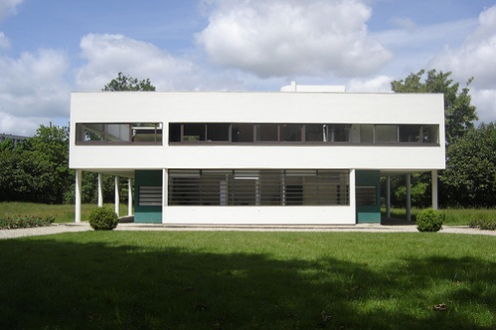
“A house is a machine for living” Le Corbusier
A house would be a "machine for living," not reducing man to the level of an automaton (a robot) but uplifting him by being in a precise, highly functional, machine like environment.

Slide 76
Le Corbusier's Villa Savoye: A Machine For Living (a 4 minute video)
Columbia University: Architecture in 360 degrees
Excellent 360 degree views of the Villa Savoye
(and other buildings as well)

Slide 77
Farnsworth House designed by Mies van der Rohe, 1949

Slide 78
“Less is more” expressed Mies van de Rohe’s minimalist aesthetic

Slide 79
Farnsworth House interior

Slide 80
Farnsworth House interior

Slide 81
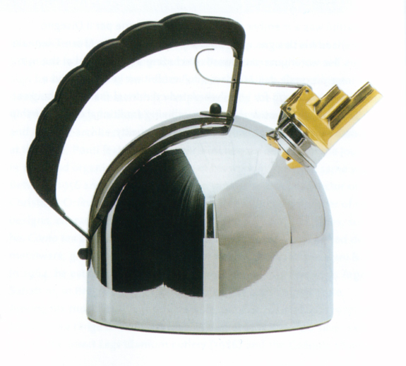
A Design Vocabulary
A visual analysis of an object: geometry
lines of force,
form
proportion
color
surface texture
material
function
manufacturing process.
A tea kettle.

Slide 82
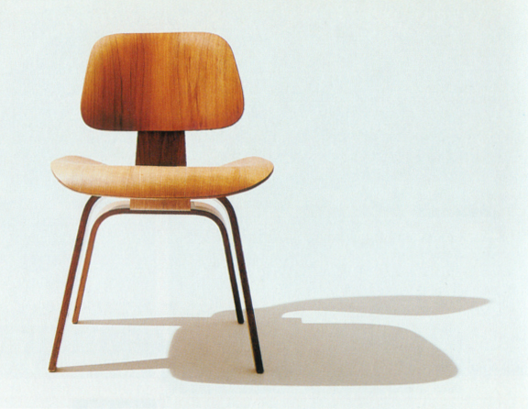
A Design Vocabulary
In well designed objects and environments an established vocabulary can be used to describe the visual elements.
The Eames Molded Plywood Lounge chair, 1946.
Form
Texture
Color
Material
Proportion

Slide 83
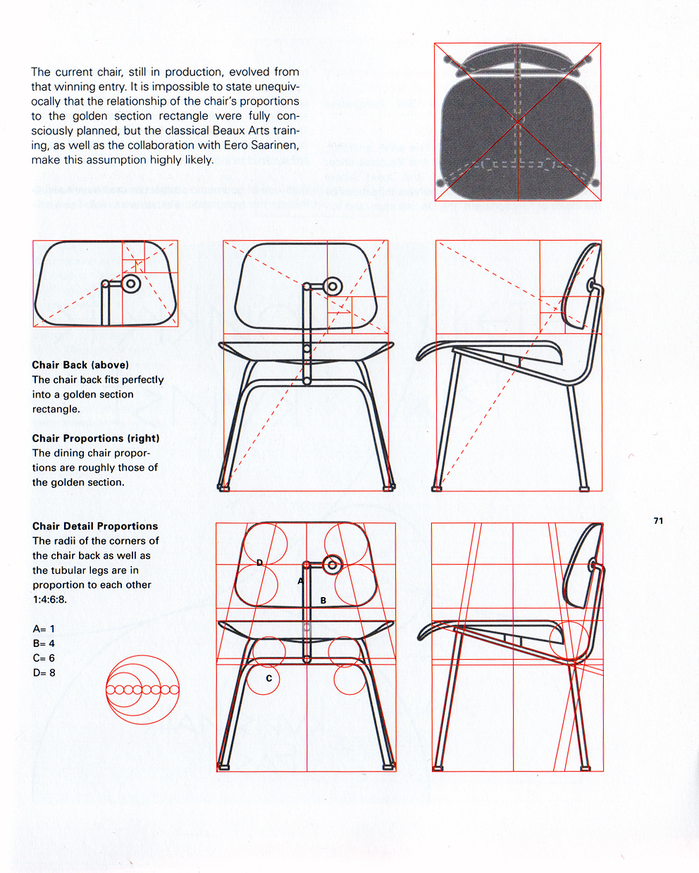
A Design Vocabulary
The design of the chair is achieved using proportions that create visual relationships between parts of the chair.
The vocabulary of design reveals the intentional way the designer has created the chair.

Slide 84
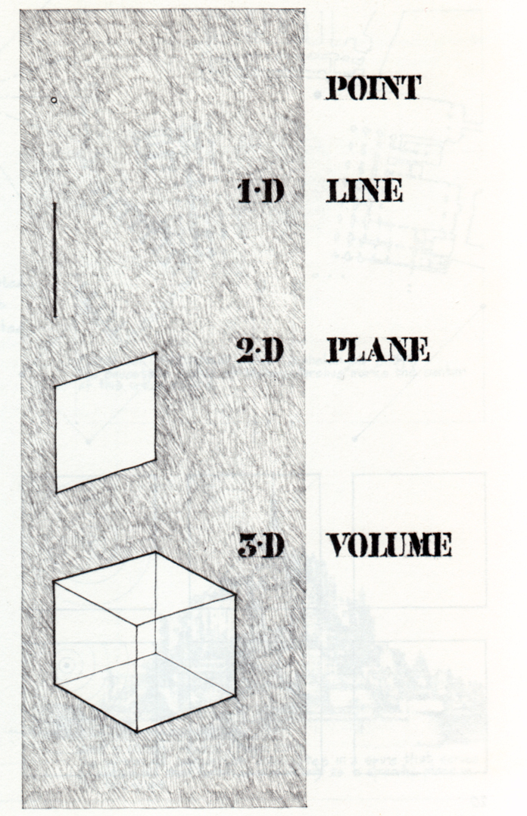
Form
Primary Elements of Form are:
Point
Line
Plane
Volume

Slide 85
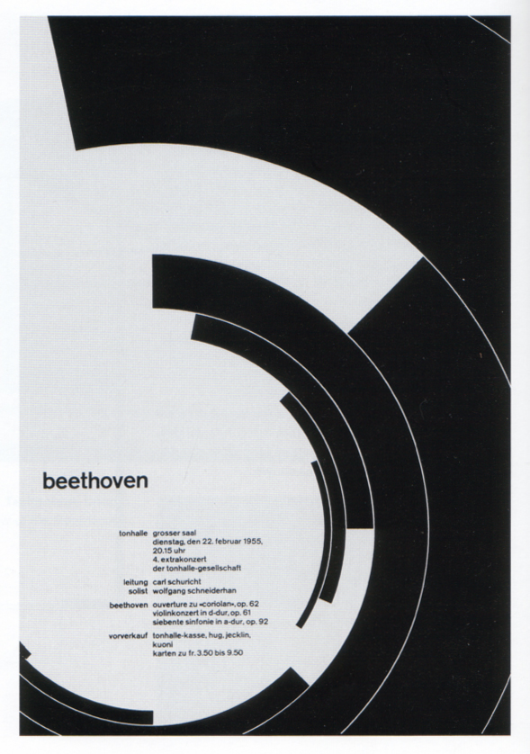
Point
Points are the generators for all form.
Points generate a position in space.

Slide 86
A Point Defines the Center of the Design of the Poster

Slide 87
A Point Defines the Center of the Design of the Room

Slide 88
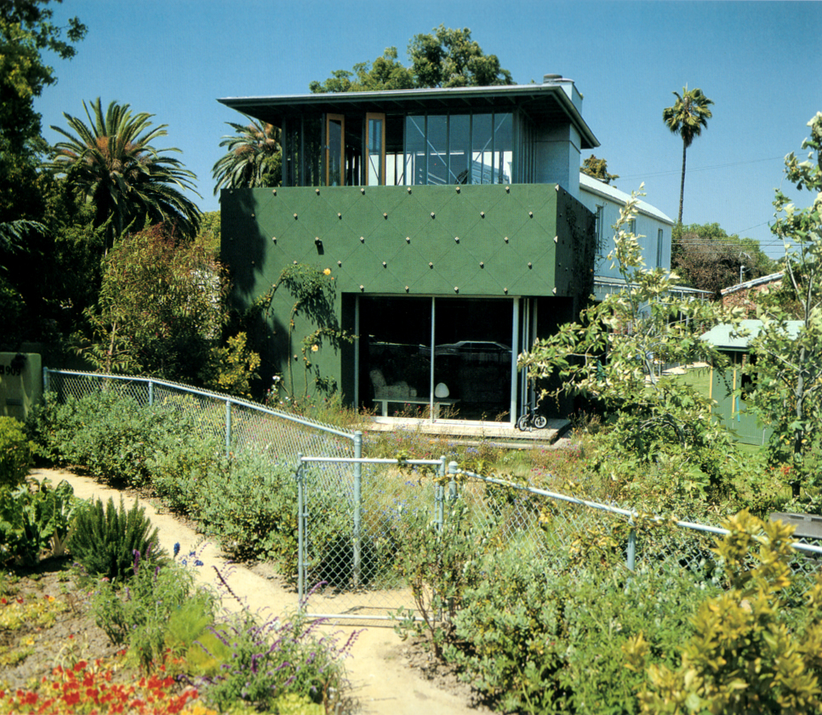
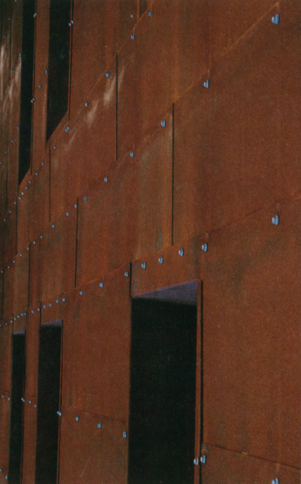
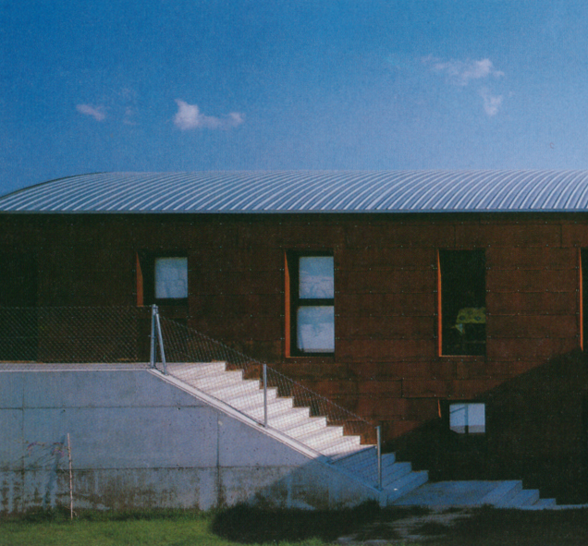
Point
Small objects may be viewed as points.

Slide 89
Line
A point extended generates a line.
Forms can have a linear quality.

Slide 90
Linear elements can be found in the built environment.

Slide 91
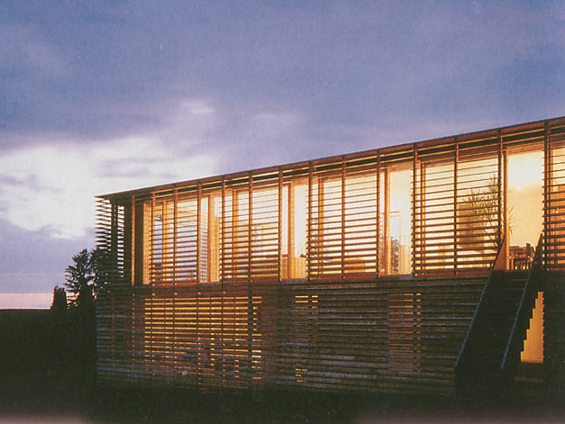
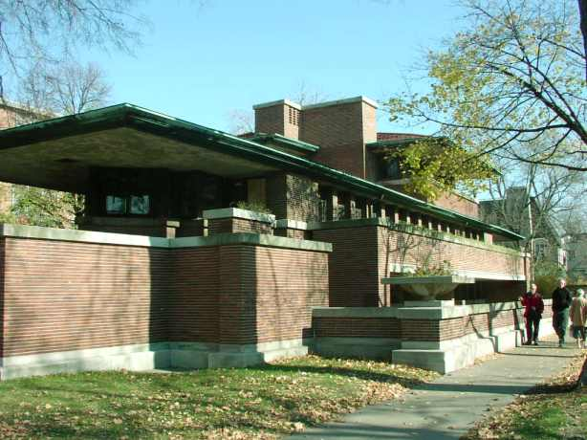
Line
Straight lines can imply a direction.
Frank Lloyd Wright’s Robie House used different colored mortar to enhance a horizontal direction with line.

Slide 92
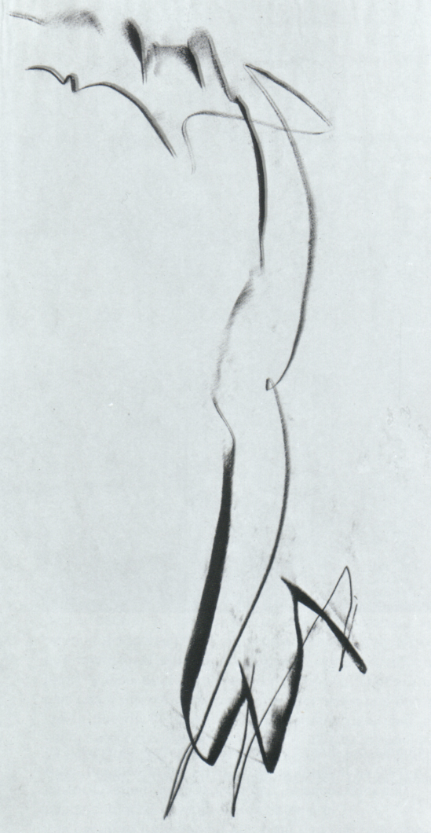
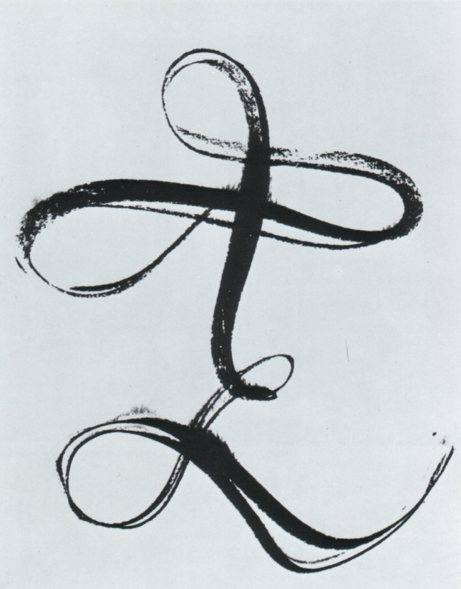
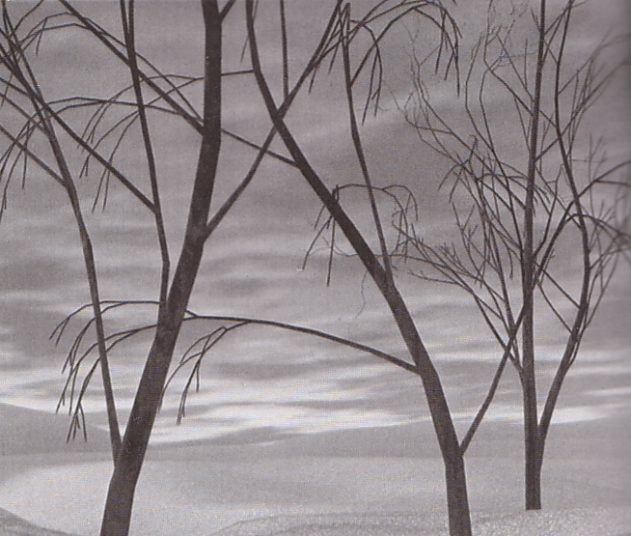
Line
Lines can have a variety of weights and textural qualities.

Slide 93
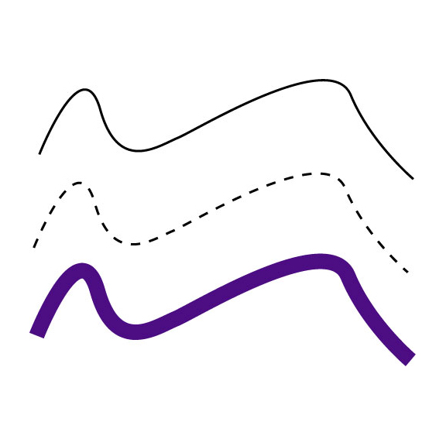
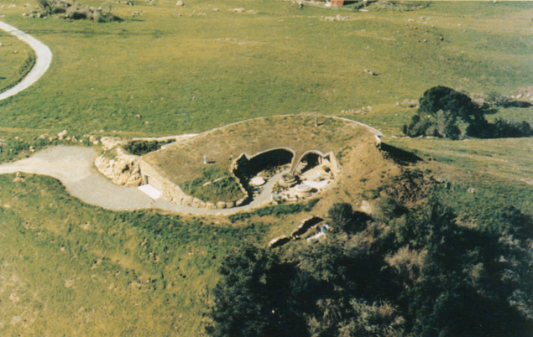
Line
Curved lines may imply movement.

Slide 95
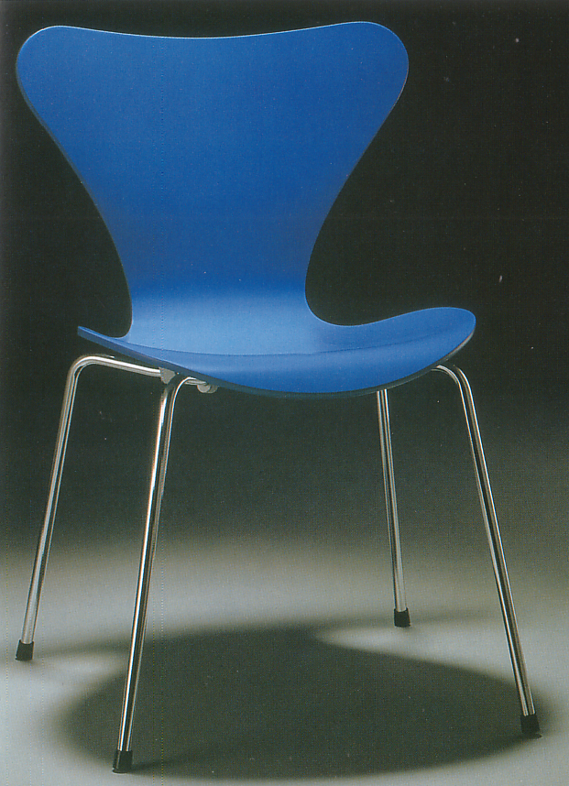
Line
Lines define shape and can enhance the understanding of edge and boundaries.

Slide 96
Line Can be Used to Create Boundaries

Slide 97
Line
Lines define shape and can enhance the understanding of edge and boundaries.

Slide 98
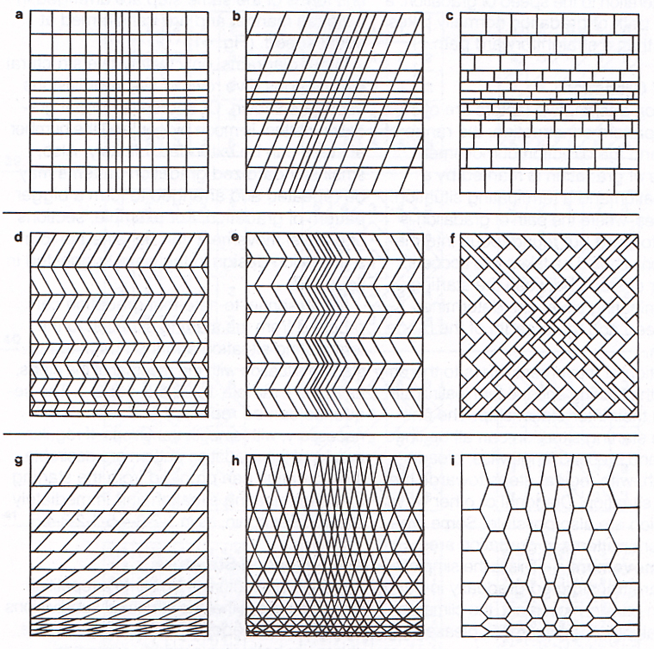
Line
Line can create texture and pattern.

Slide 99
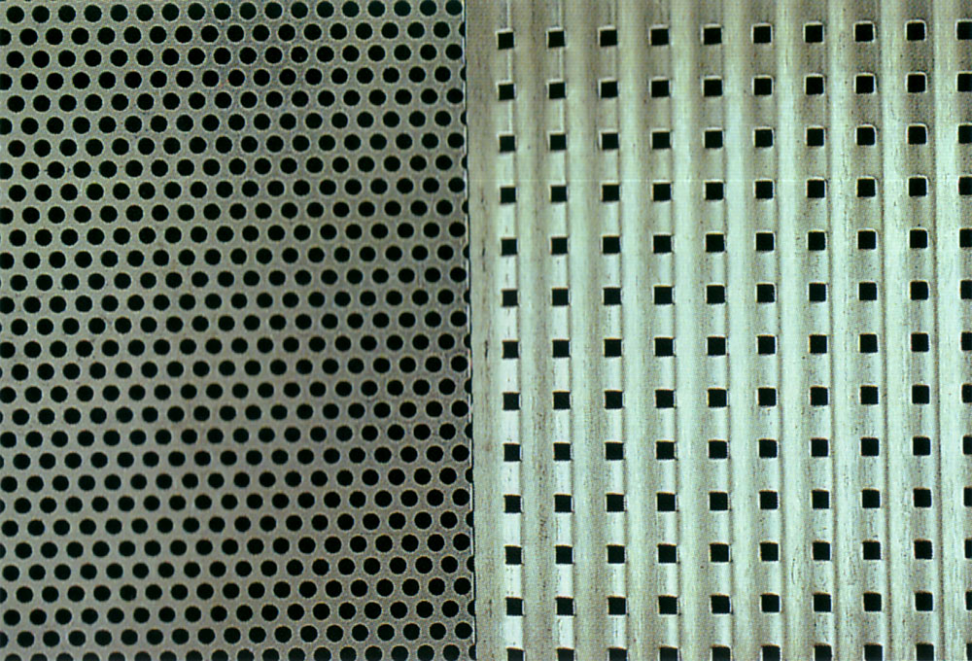
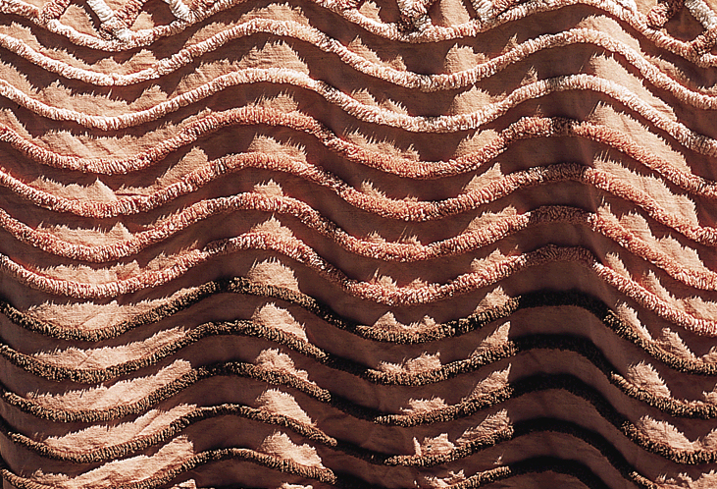
Line can create texture and pattern.

Slide 100
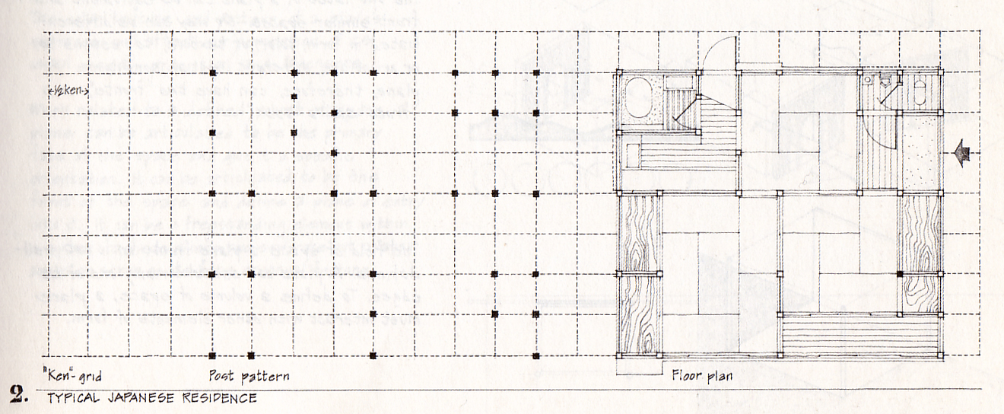
Line
Linear patterns help establish the structural system in a building.

Slide 102
Plane
A line shifted in a direction will create a plane.
Shape is the primary characteristic of a plane.

Slide 103
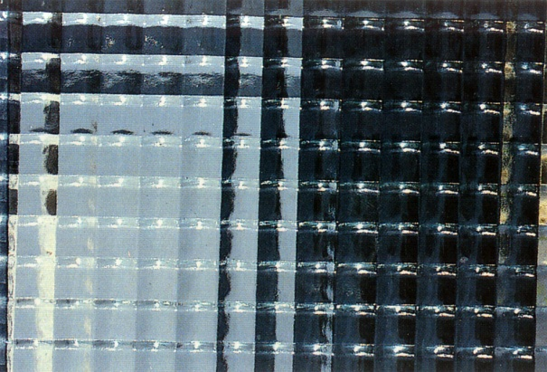
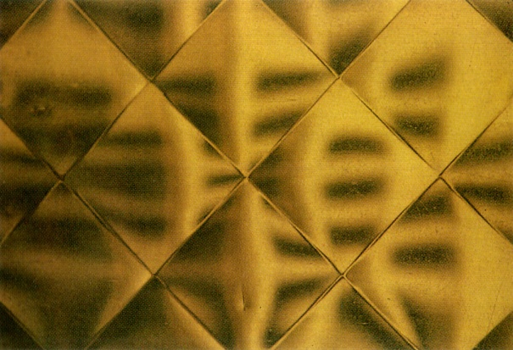
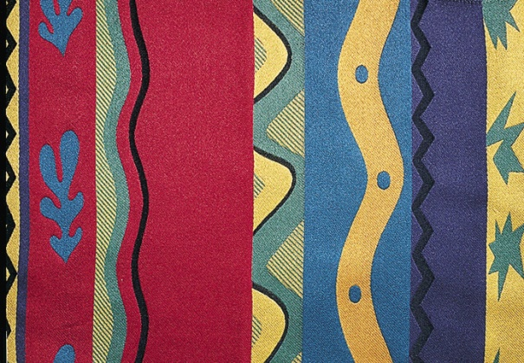
Plane
Planes have surface qualities:
Material
Color
Texture
Pattern

Slide 104
Plane
The material aspects of a plane will impact the following:
Visual Weight
Light Reflectivity
Tactile Quality
Acoustic Properties

Slide 105
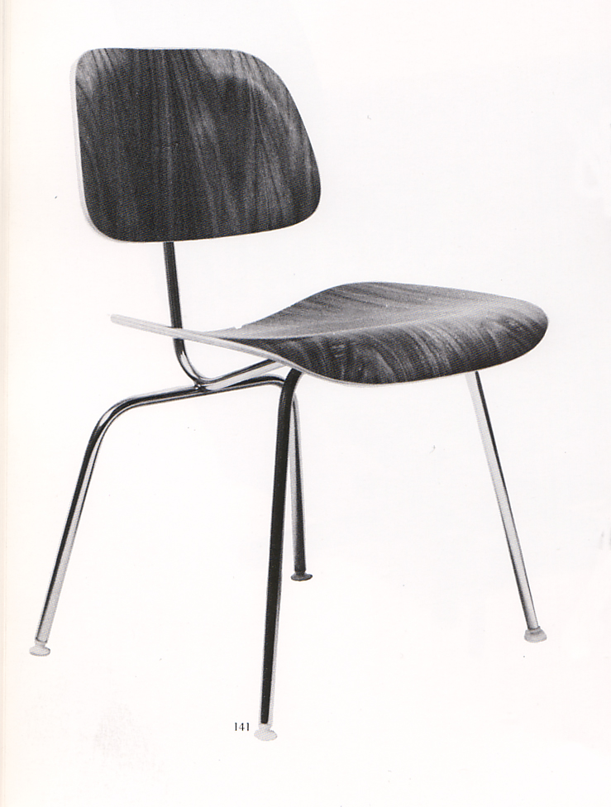
Plane
Planes are primary elements for designers.
Ray and Charles Eames designed a chair using steam bent plywood planes and solid steel rods. The planes conform the shape of the body.

Slide 106
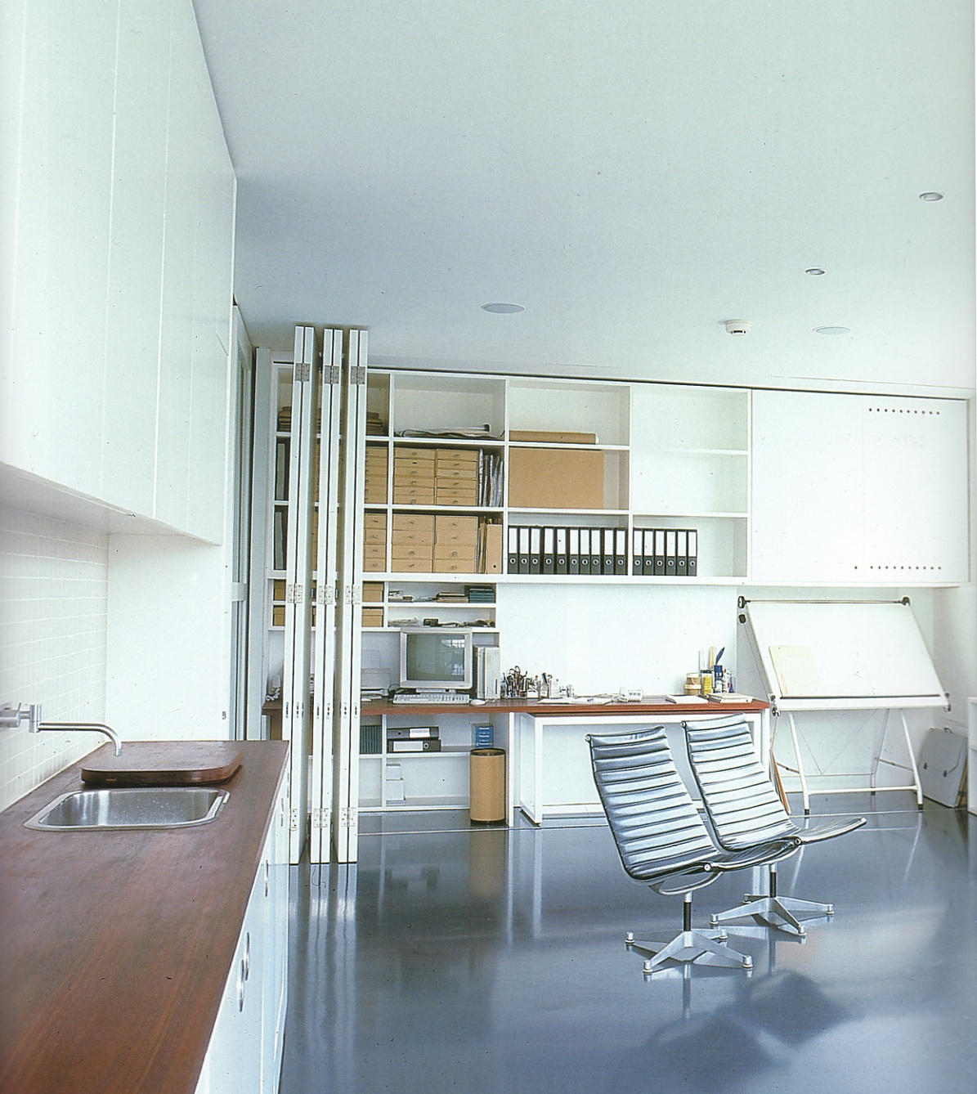
Plane
Planes are primary elements for designers.
Planes are used in an architectural context to create walls, floors, ceilings, doors, shelving and other surfaces and objects.

Slide 107
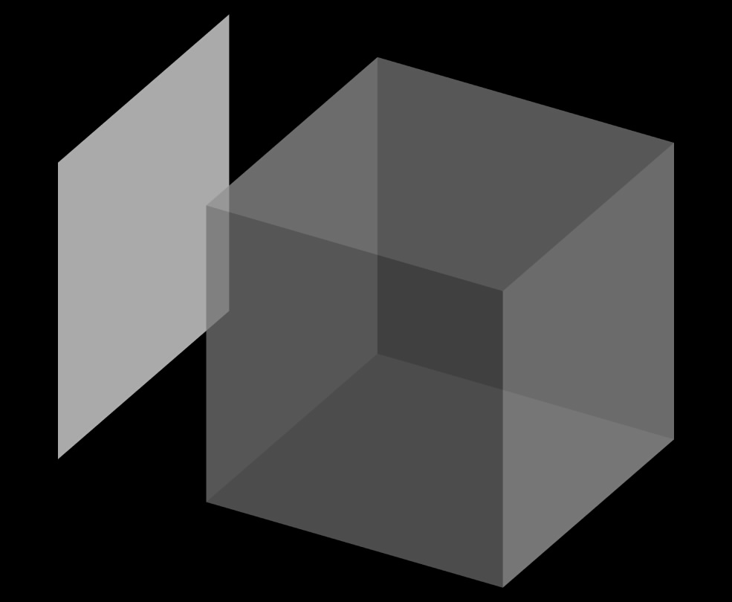
Volume
Two points create a line.
Three points create a plane.
An extended plane will create a volume.
Volumes are
3-dimensional.

Slide 108
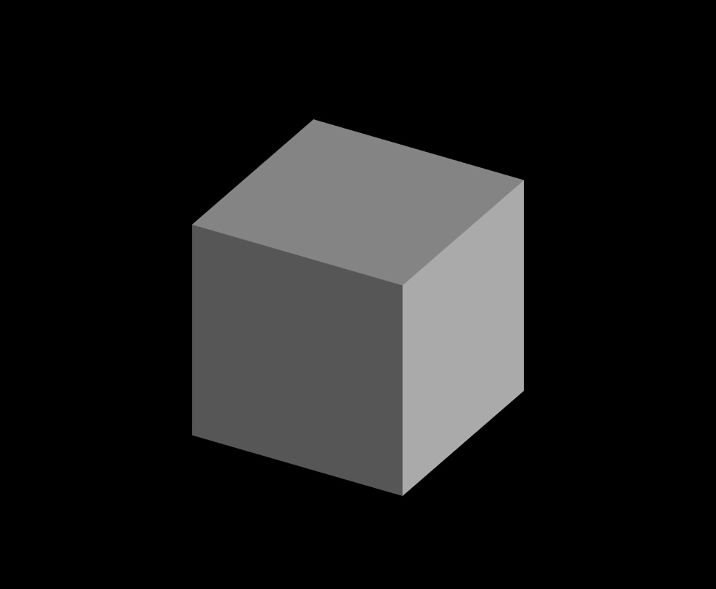
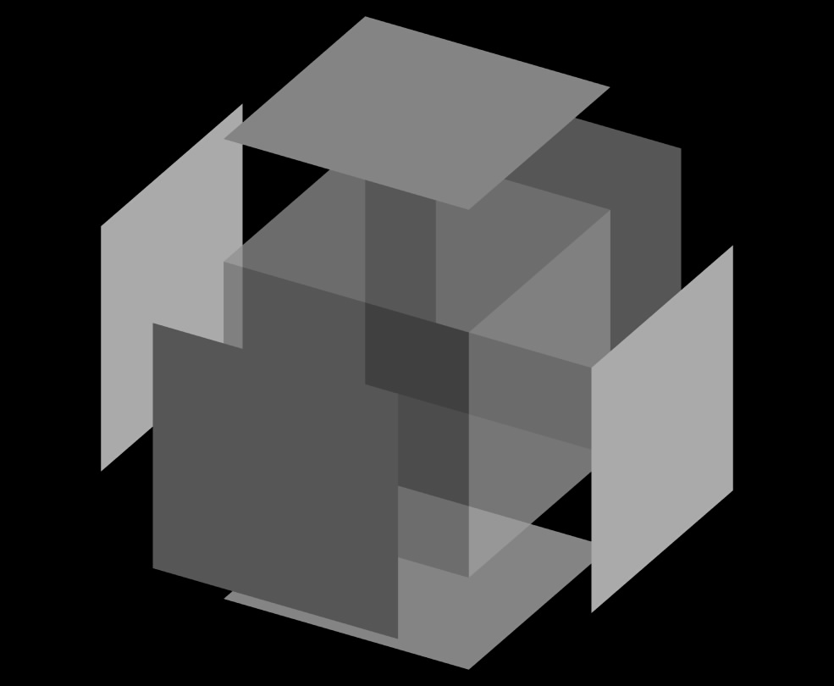
Volume
Volumes as positive spatial elements, and voids as negative spatial elements, are an important duality in designing three dimensionally.

Slide 109
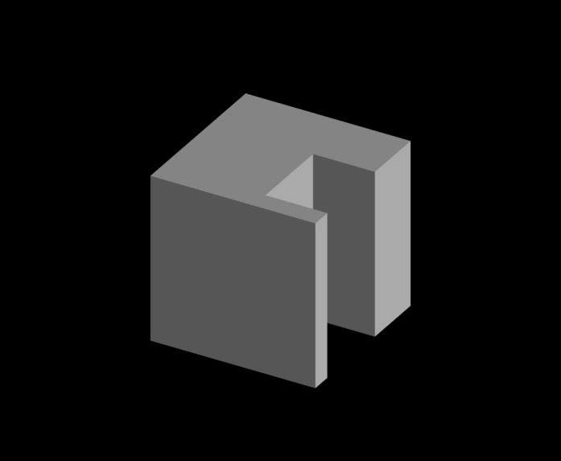
Volume
Solid, void, mass, and space, are all important aspects of describing and experiencing volume.

Slide 110
Furnishings with “mass” contrasting with linear elements.

Slide 111
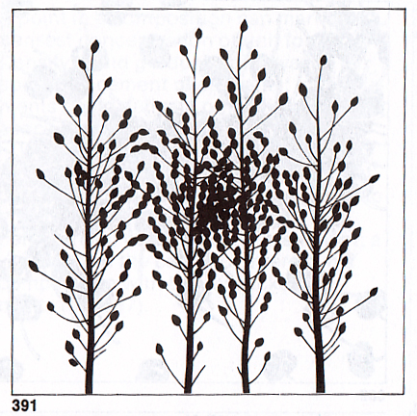
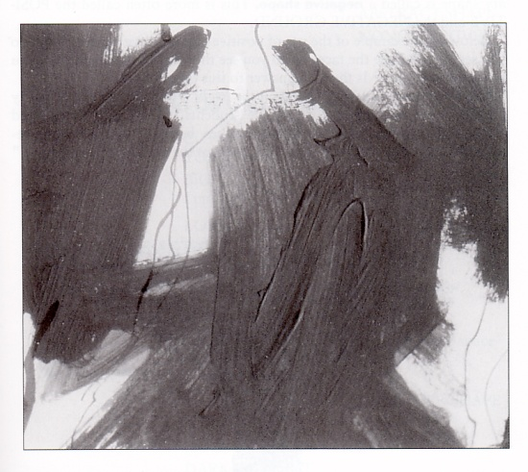
Form/Shape
Shape is the central way a designer distinguishes one form from another.
Natural Shapes – Derived from Nature
Non-objective shapes – Abstract or Symbols
Geometric Shapes (Sphere, Cube, Cone, Cylinder, Pyramid)

Slide 112
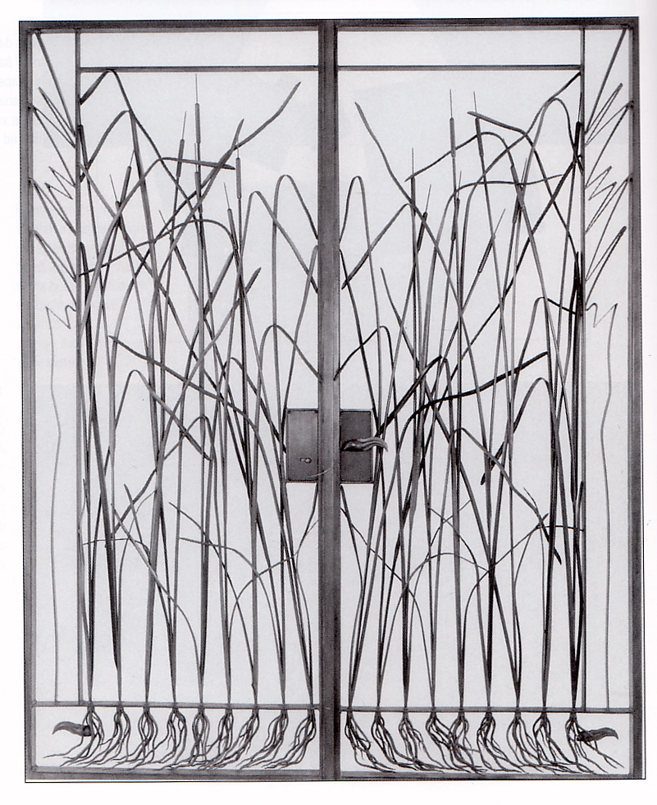
Form/Shape
Natural Shapes
Used in the design of a set of doors.

Slide 113
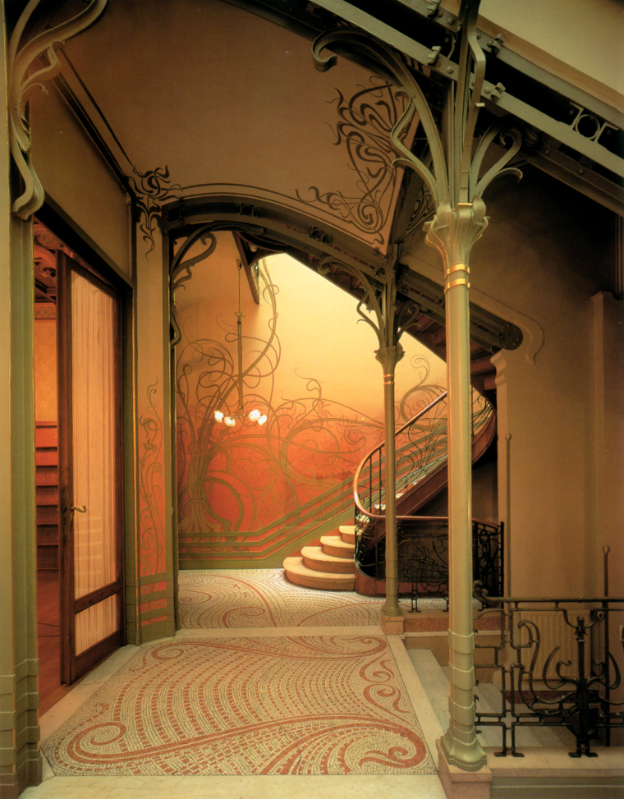
Form/Shape
Natural Shapes
Natural shapes used in Art Nouveau design work

Slide 114
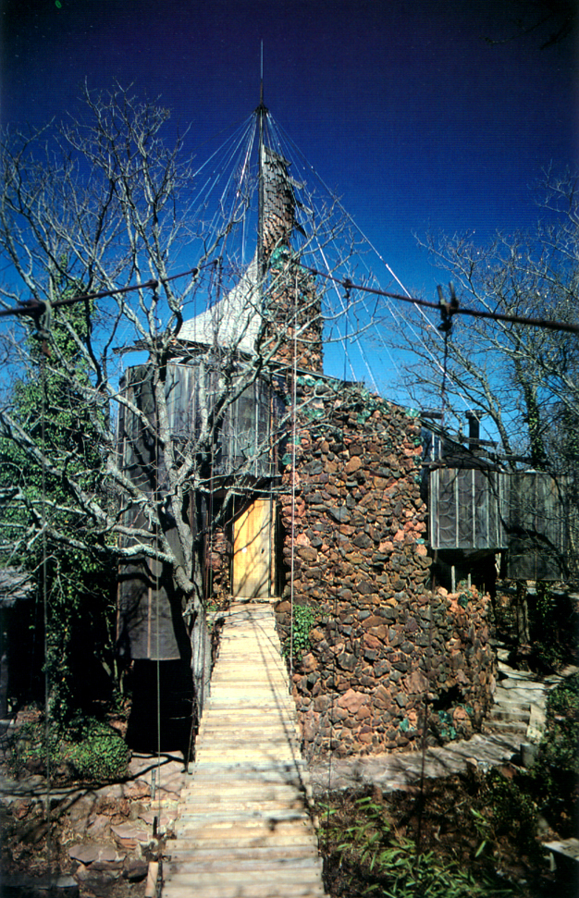
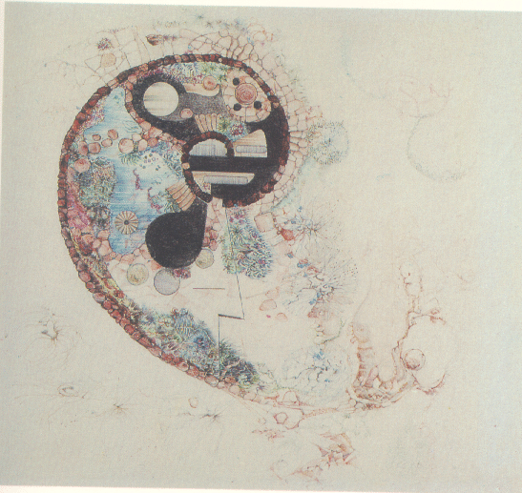
Form/Shape
Natural Shapes
Bruce Goff, American architect,1904-1982, used organic or shapes inspired from nature to design homes.

Slide 115
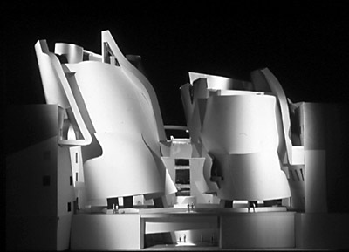
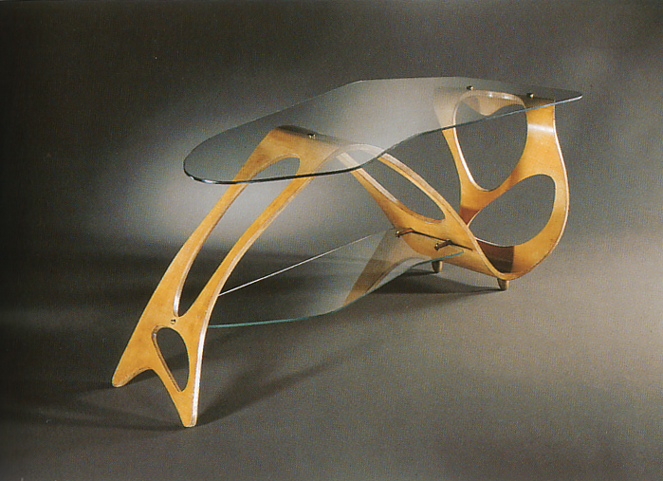
Form/Shape
Non-objective, non representational, Shapes
Abstract or Symbolic

Slide 116
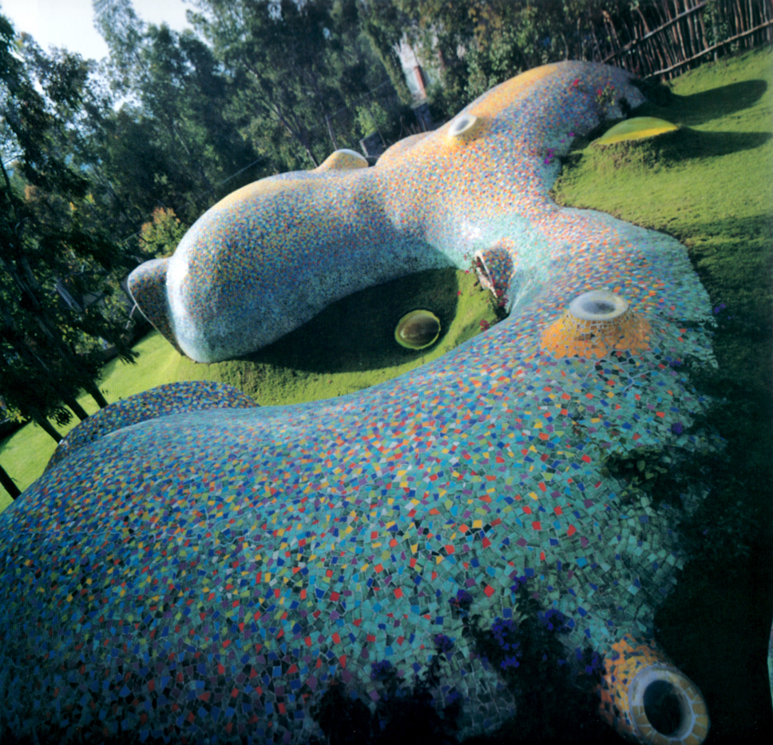
Non-objective Shapes, Abstract or Symbolic

Slide 117
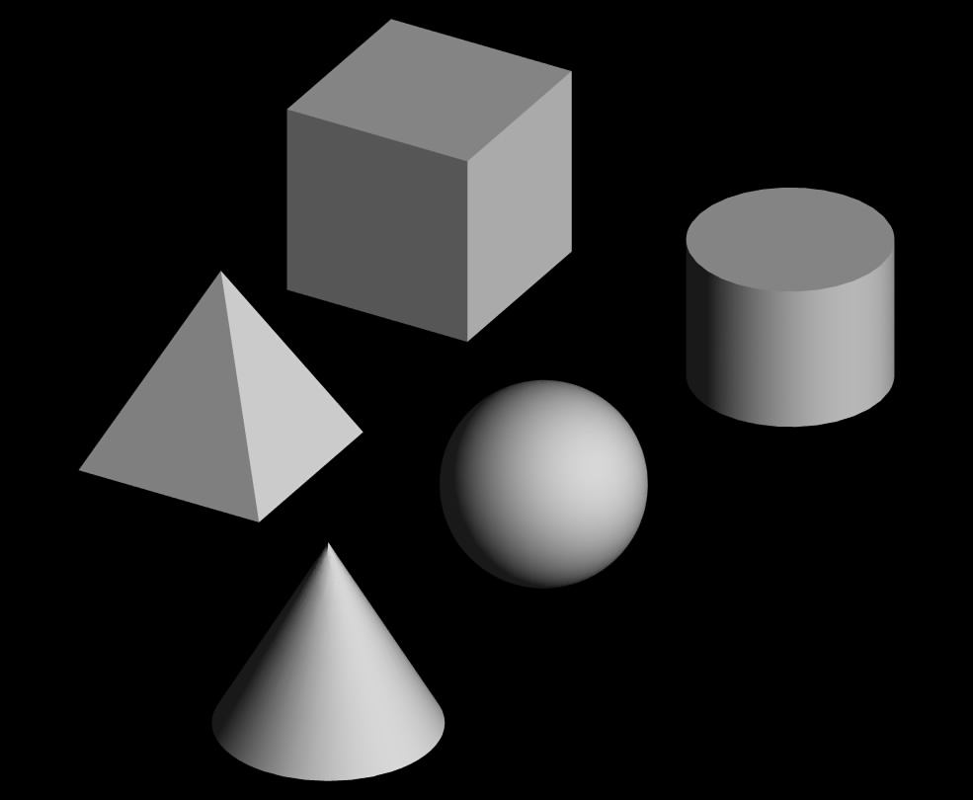
Form/Shape
Regular Geometric Shapes
Dominate the design of residential structures.
Use of both rectilinear and curvilinear forms.
(Sphere, Cube, Cone, Cylinder, Pyramid)

Slide 118
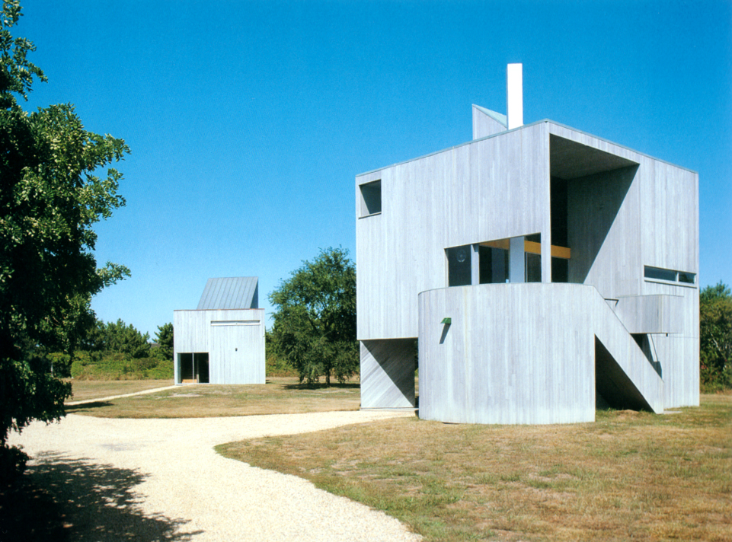
Strong geometric form is easy to ‘read’

Slide 119
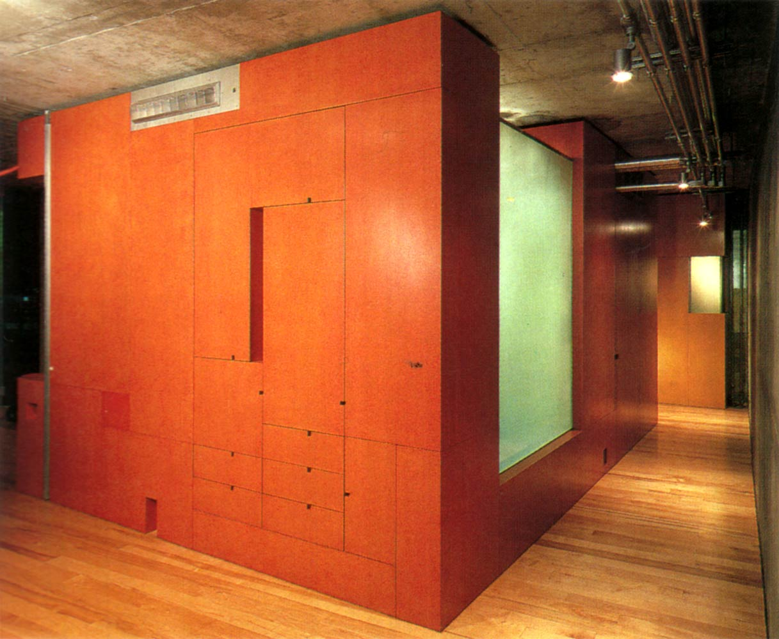

Slide 120
The purpose of looking at the images in this Lecture set, and of thinking about the concepts is to expand the way you approach, look at, and appreciate, architecture and design.
Merely looking at a room, a house, a building, a chair, can only provide you with limited information.
The story behind these is essential if you are seeking a greater understanding, an ‘appreciation’.

